Slide 1
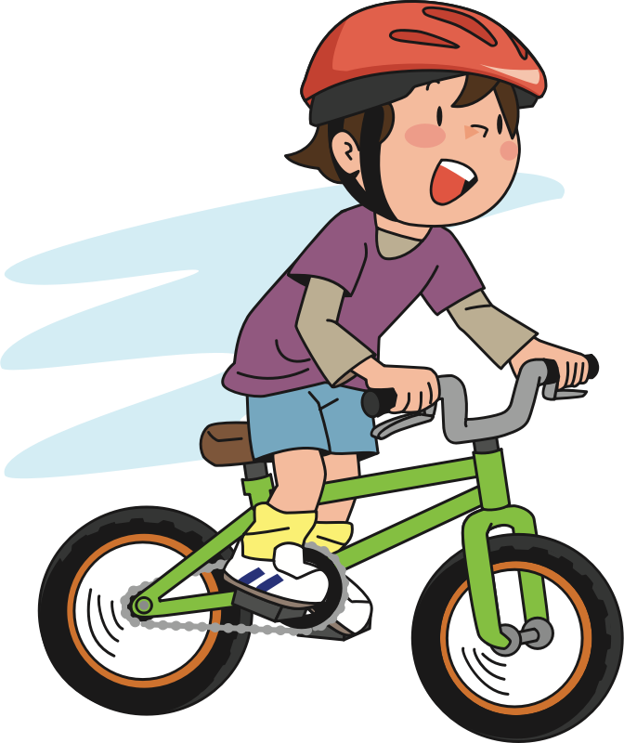
Here is Andy. He is at the park riding his bike.

Slide 2


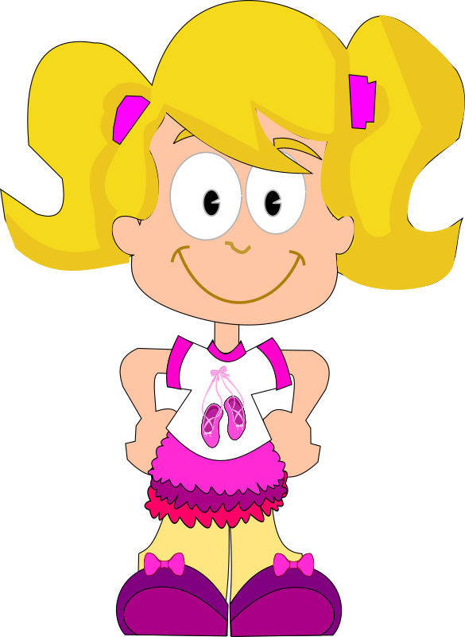
Here is Suzy. She is at the park watching butterflies.

Slide 3
Andy is riding his bike very fast…

Slide 4
…and is coming around a corner.

Slide 5
As he comes around the corner…

Slide 6
….he ends up running right into Suzy!

Slide 7
Suzy fell into the fence!

Slide 8
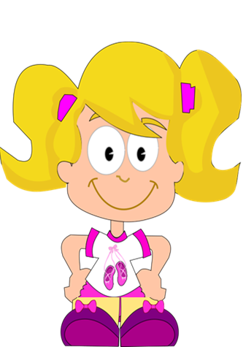
The fence ended up breaking! See the fence is broken!

Slide 9
Luckily nobody got hurt—Suzy and Andy were both OK.

Slide 10
Now that you saw what happened, we will ask you a couple of questions

Slide 11
Who caused the fence to break?

Slide 12
Who broke the fence?

Slide 13
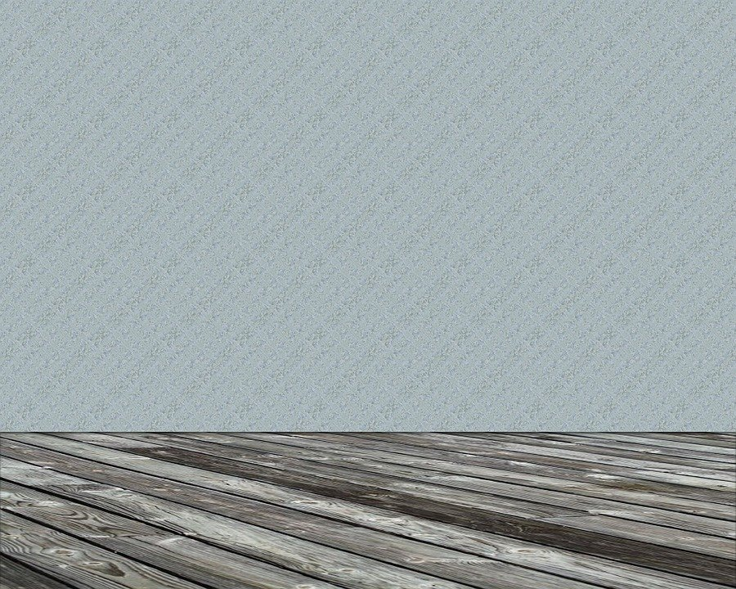
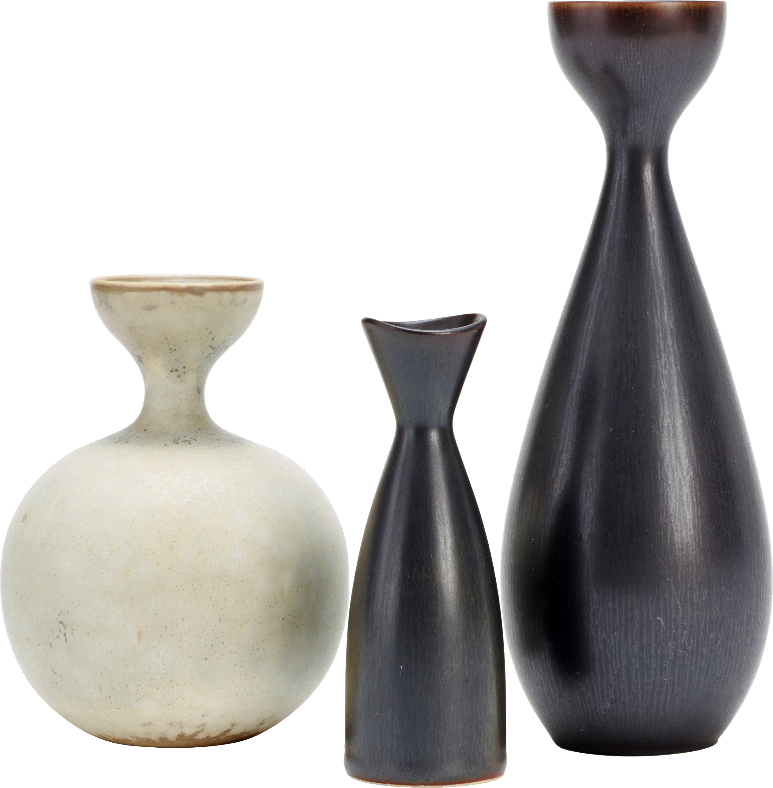
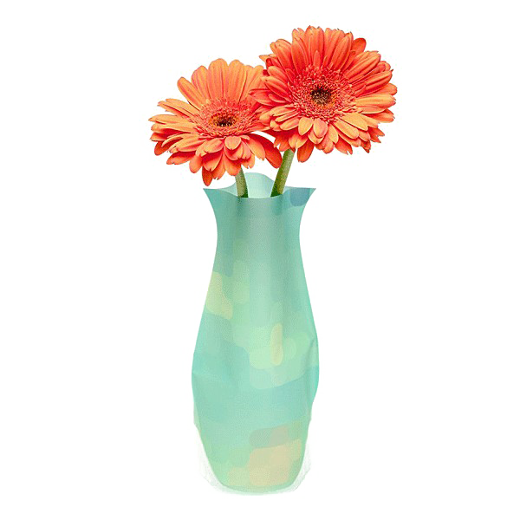
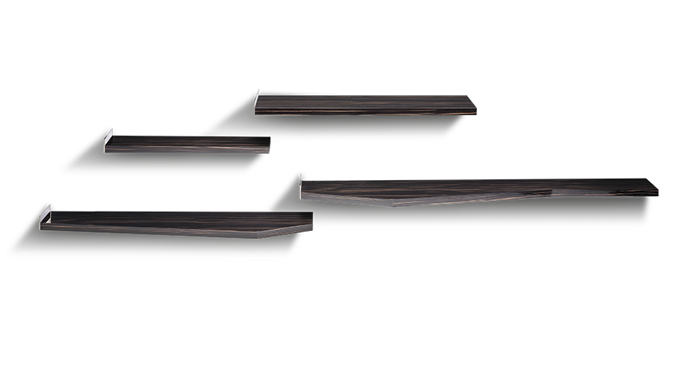
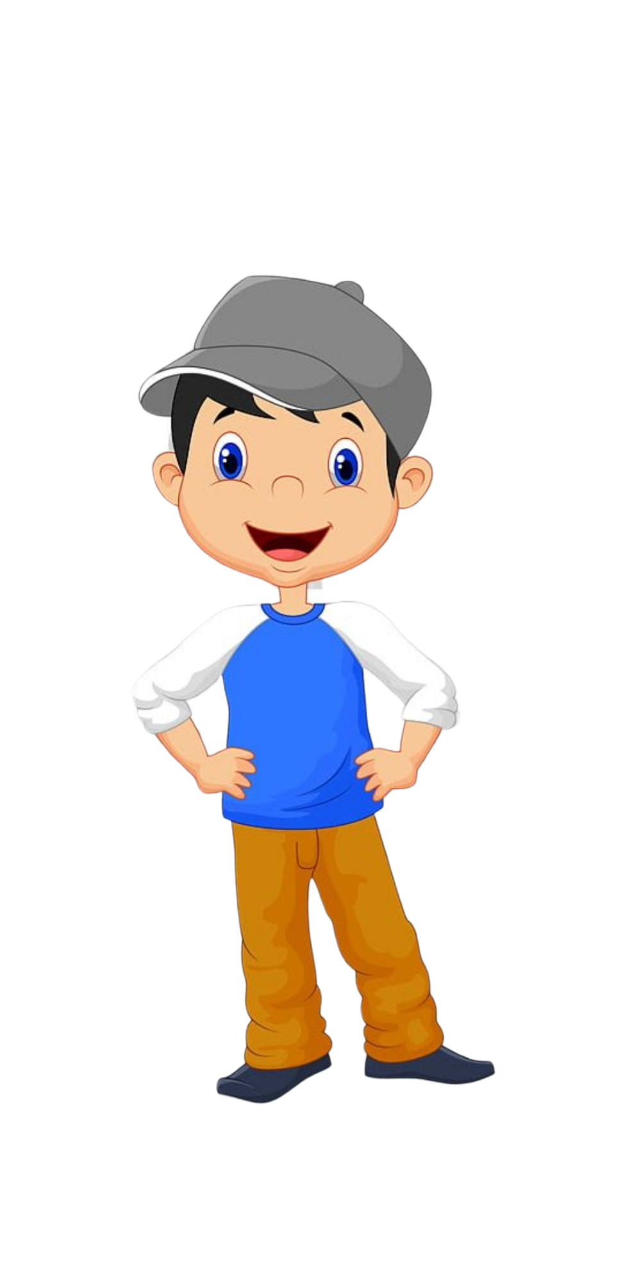





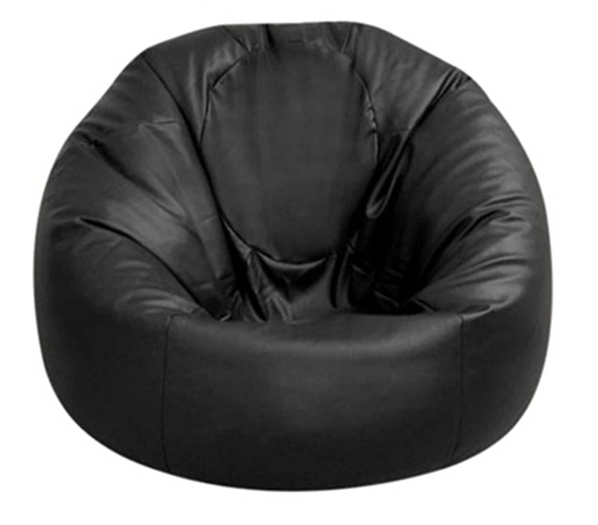
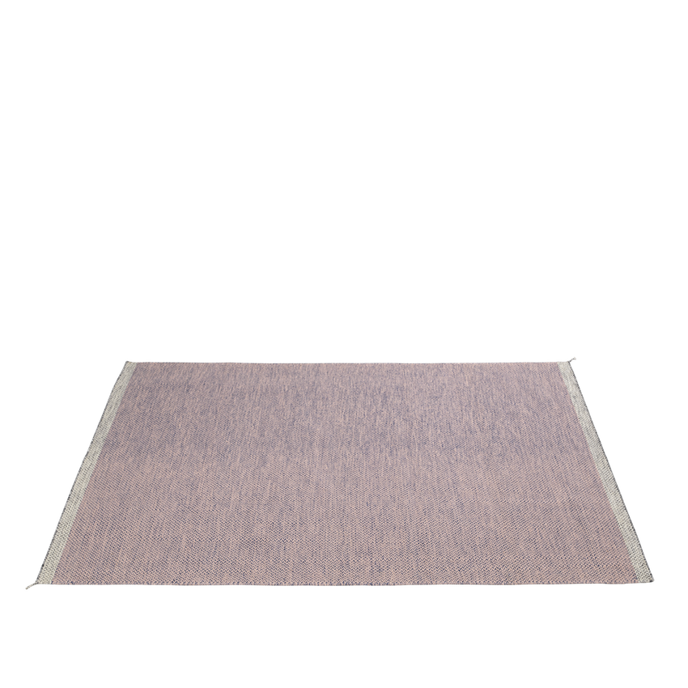

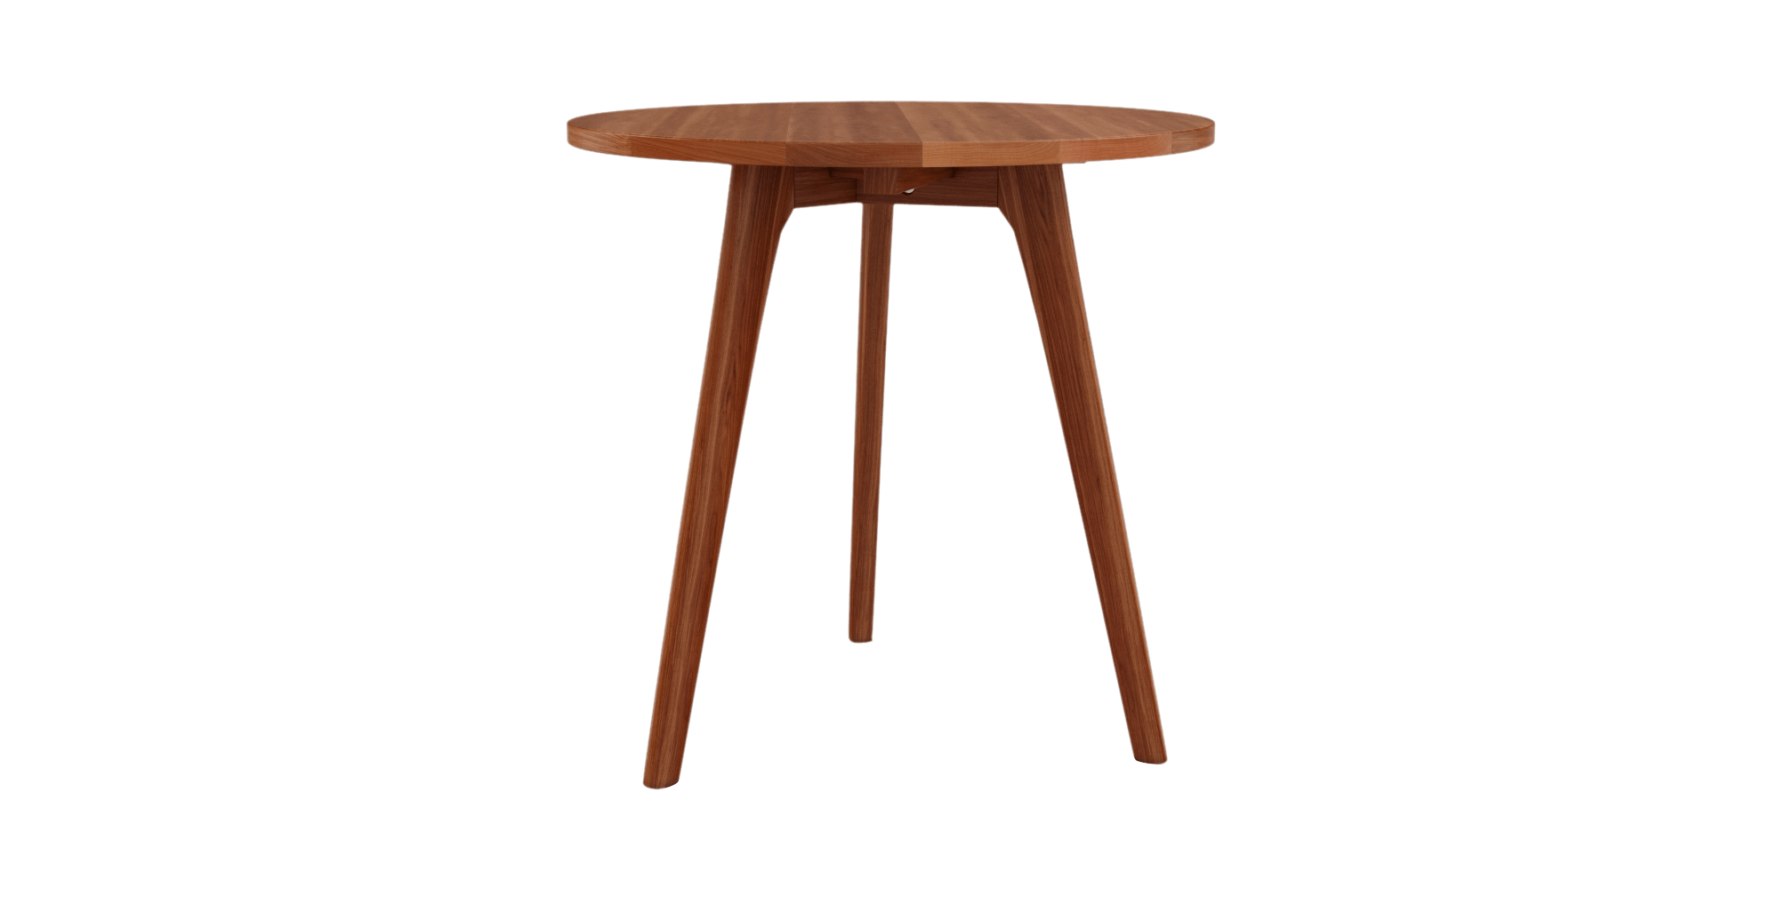
This is Bobby

Slide 14

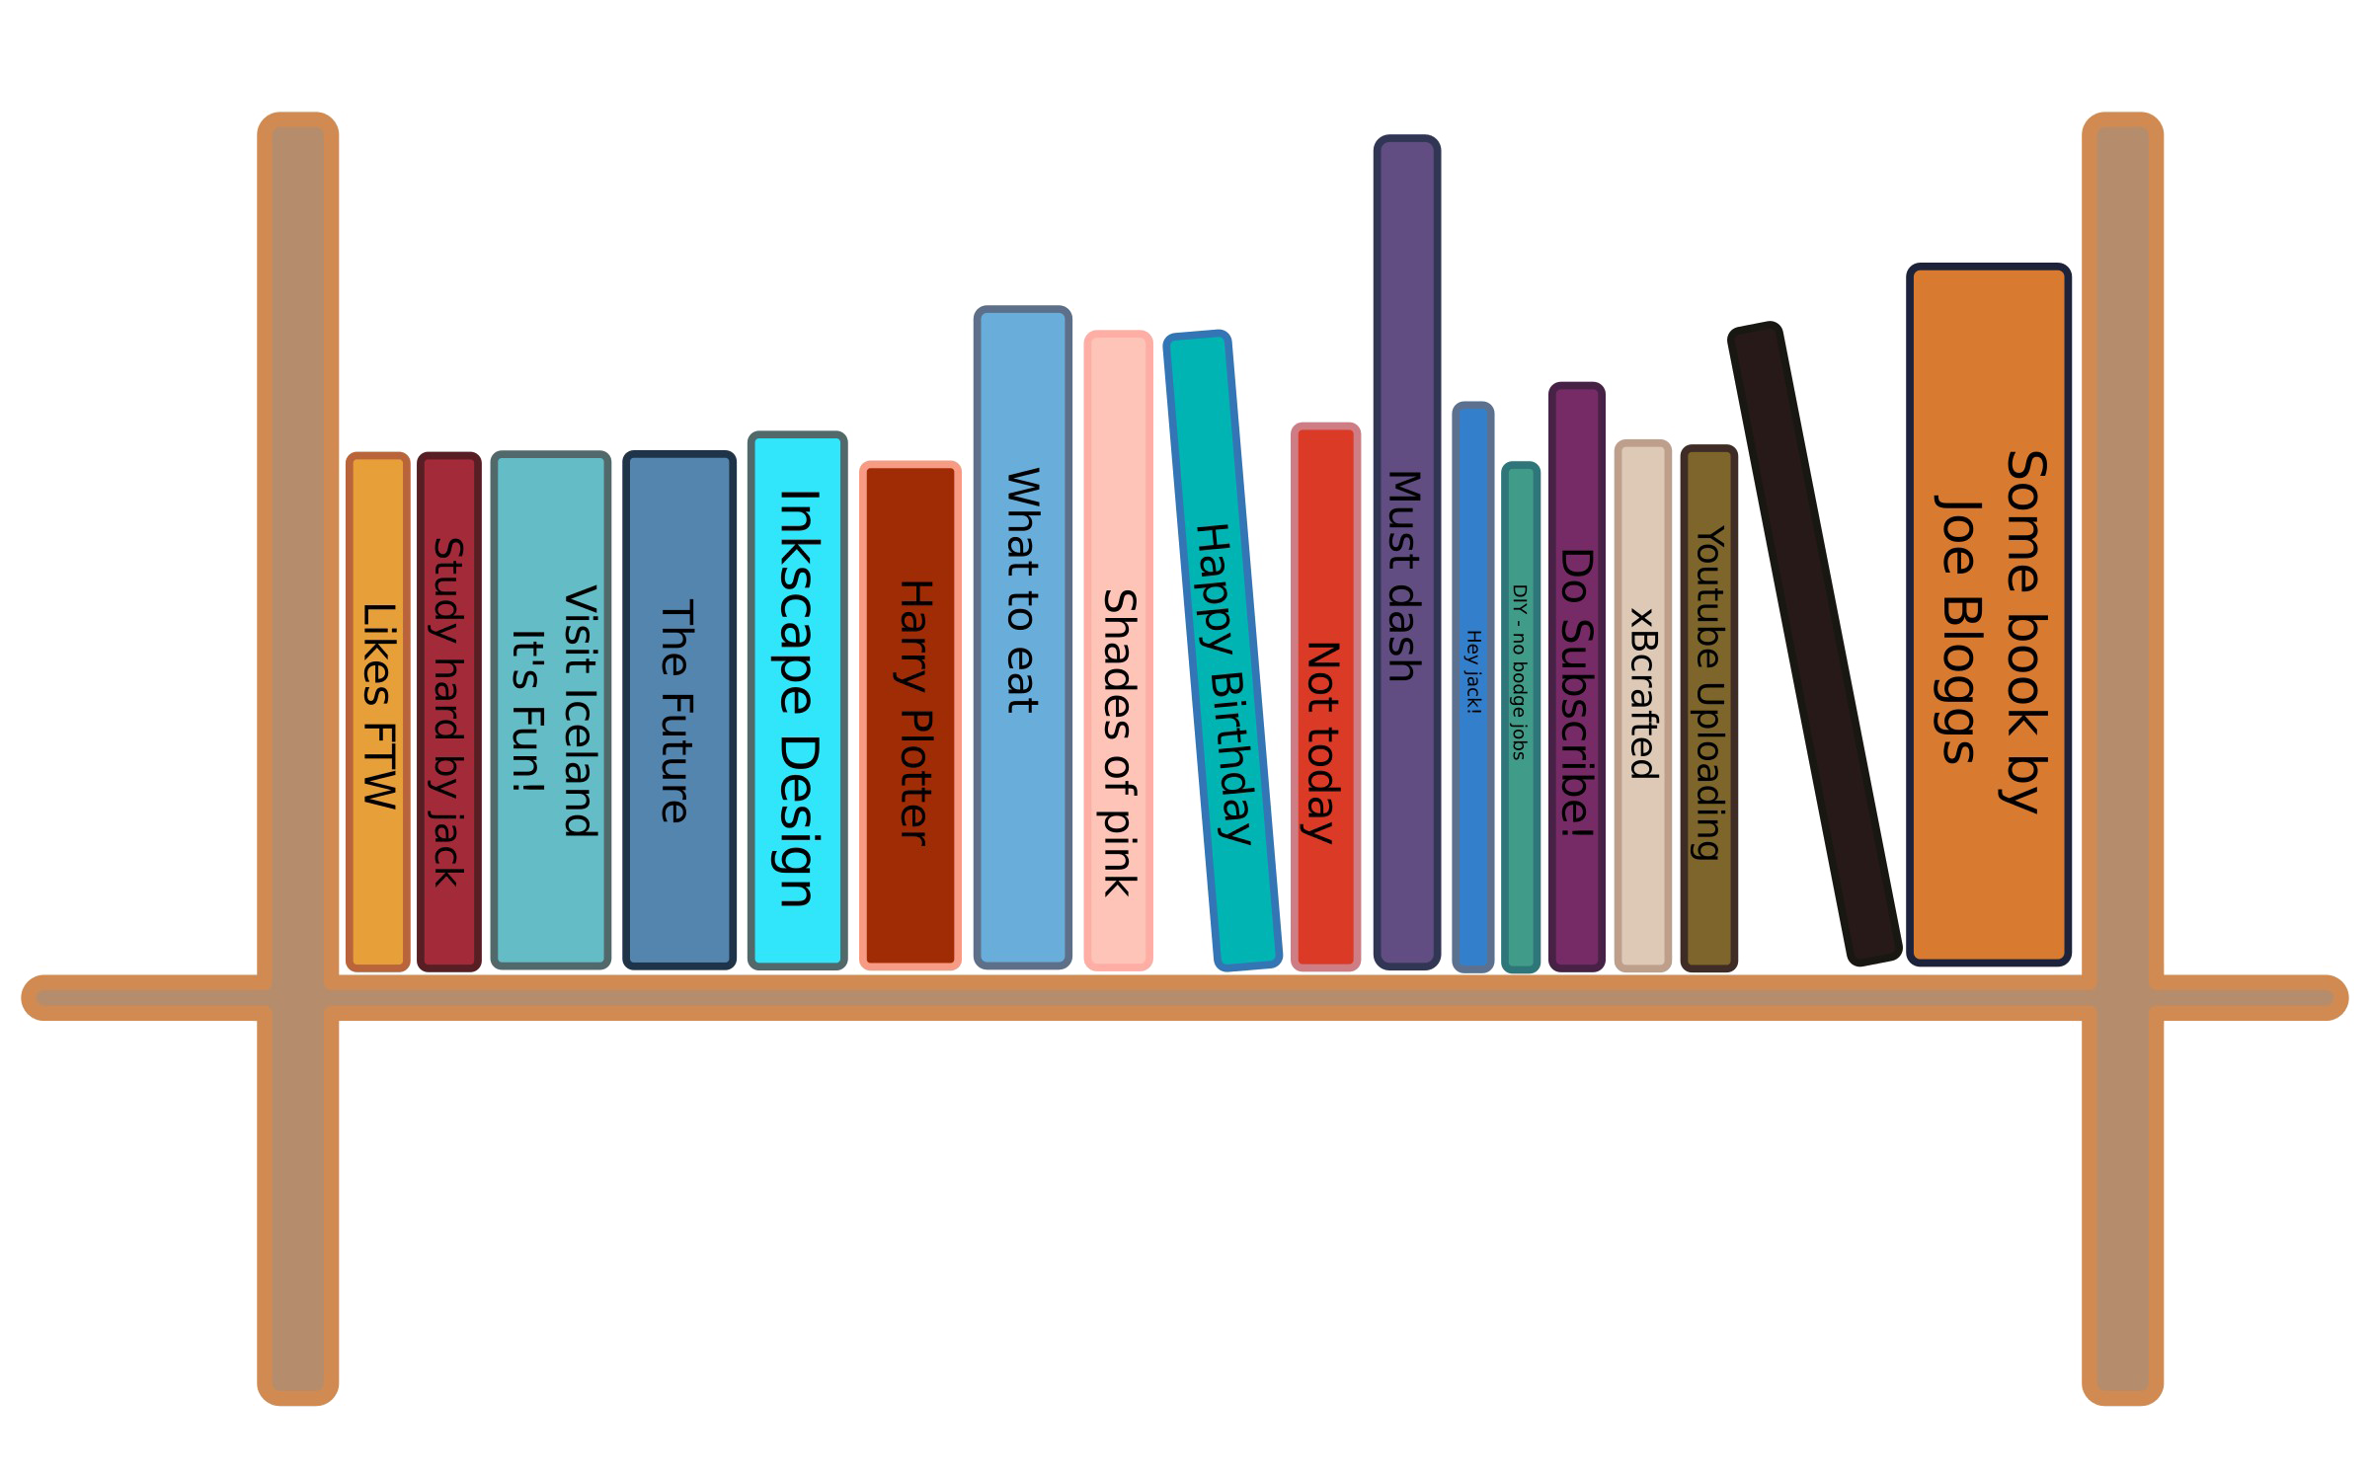


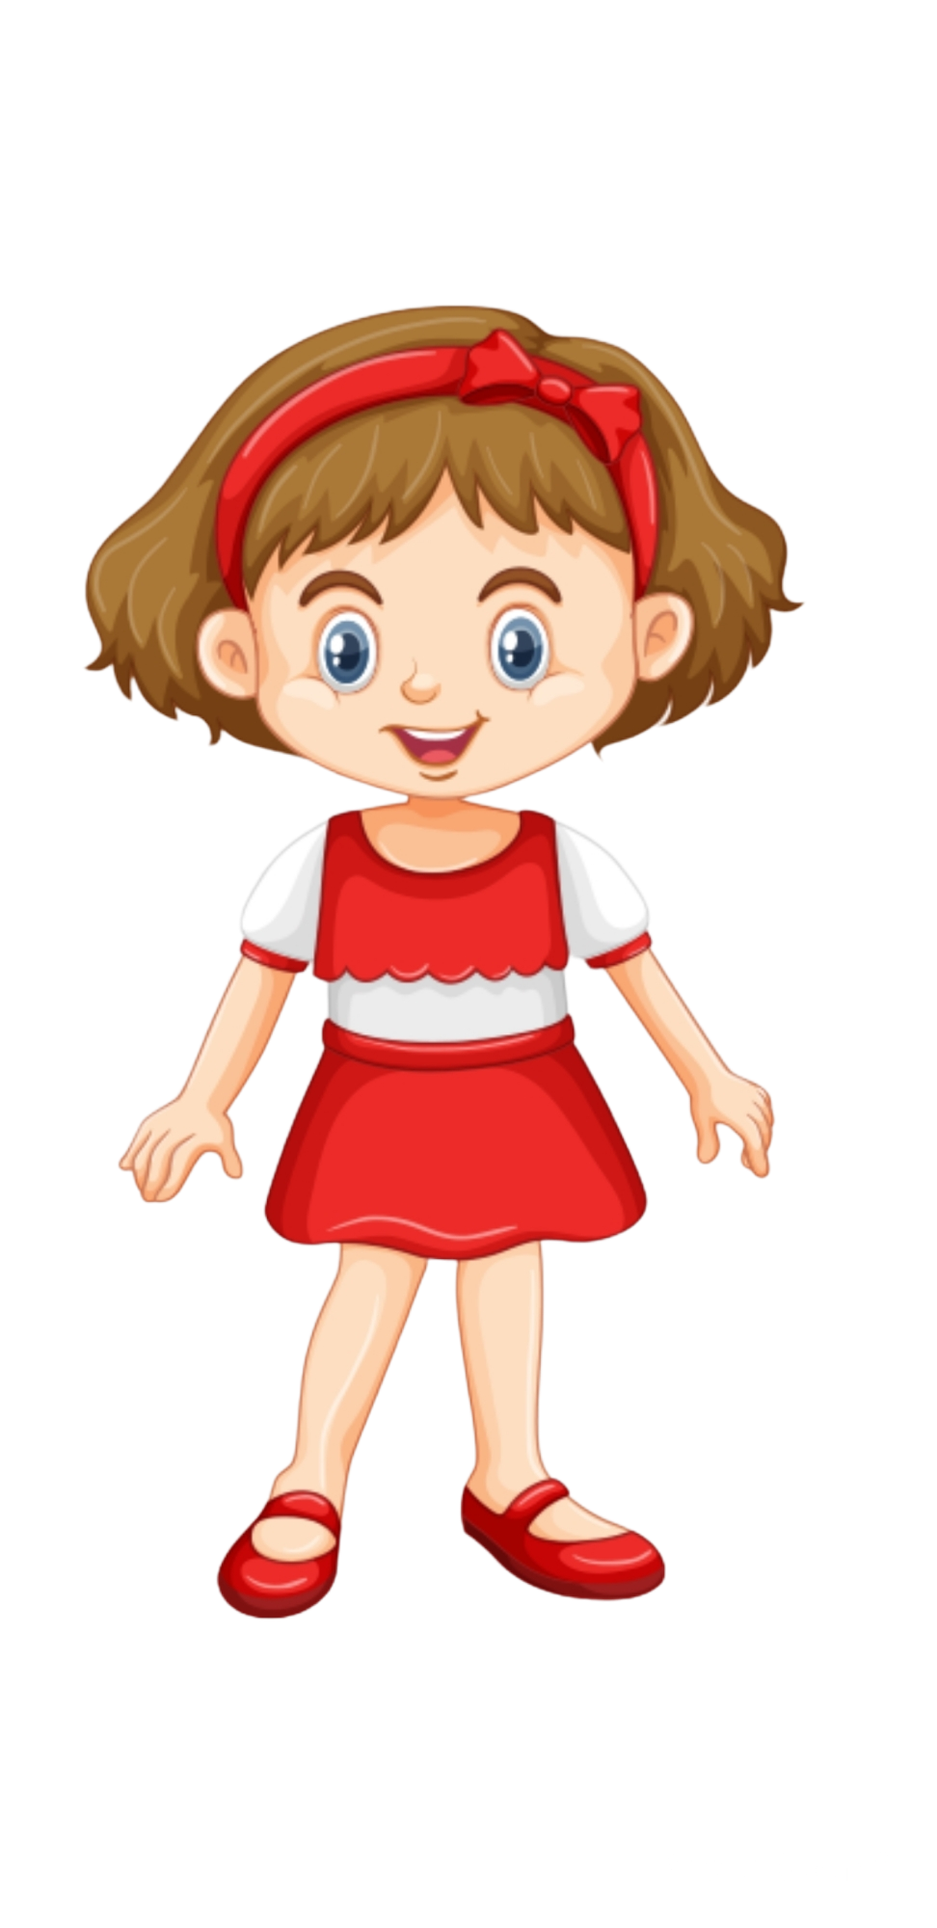

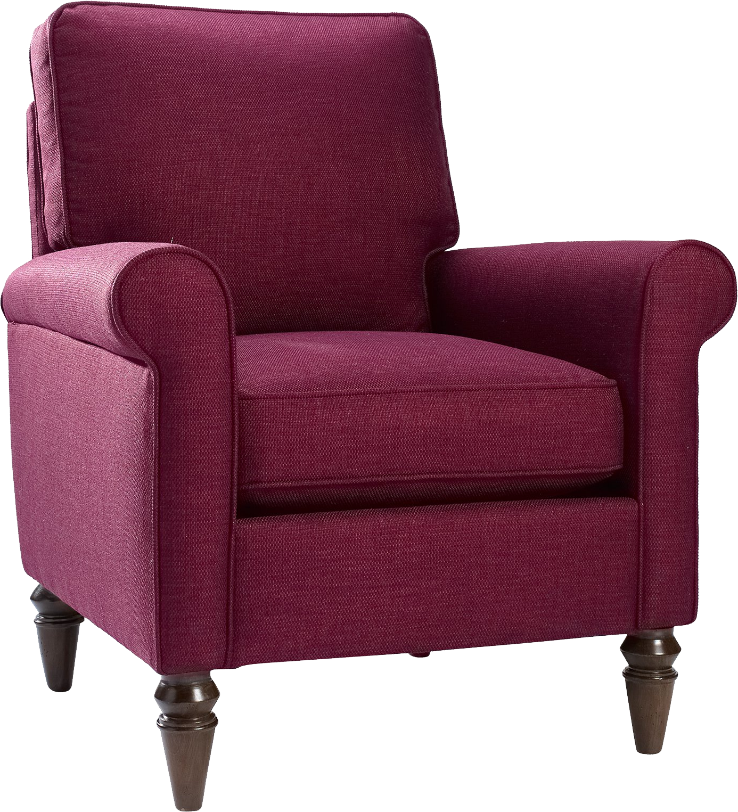
And this is Sophia

Slide 15
Sophia decides that she wants to scare Bobby

Slide 16
Sophia decides that she will hide behind the chair

Slide 17
Then she will call Bobby into the room and jump out to scare him!

Slide 18
Sophia goes to hide behind the chair.

Slide 19
See Sophia is hiding behind the chair.

Slide 20
Now she calls Bobby into the room

Slide 21
Bobby is now in the room

Slide 22
Sophia then jumps out and goes …

Slide 23
Boo!

Slide 24
Bobby falls into the mirror!

Slide 25
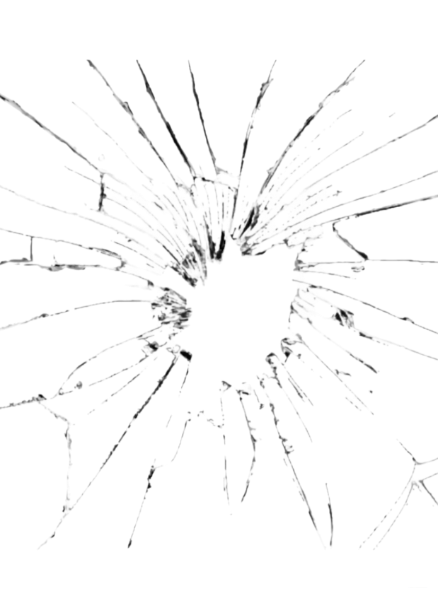
The mirror ended up cracking. See the mirror is cracked!

Slide 26
Luckily nobody got hurt—Bobby was OK.

Slide 27
Now that you saw what happened we would like to ask you a couple of questions

Slide 28
Who caused the mirror to crack?

Slide 29
Who cracked the mirror?

Slide 30
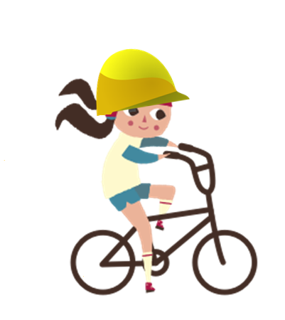
Here is Suzy. She is at the park riding her bike.

Slide 31

Here is Andy. He is at the park watching butterflies.

Slide 32

Suzy is riding her bike very fast…

Slide 33
…and is coming around a corner.

Slide 34

As she comes around the corner…

Slide 35
…she ends up running right into Andy!

Slide 36
Andy fell into the fence!

Slide 37


The fence ended up breaking! See the fence is broken!

Slide 38
Luckily nobody got hurt—Suzy and Andy were both OK.

Slide 39
Now that you saw what happened, we will ask you a couple of questions

Slide 40
Who caused the fence to break?

Slide 41
Who broke the fence?

Slide 42
This is Sophia

Slide 43
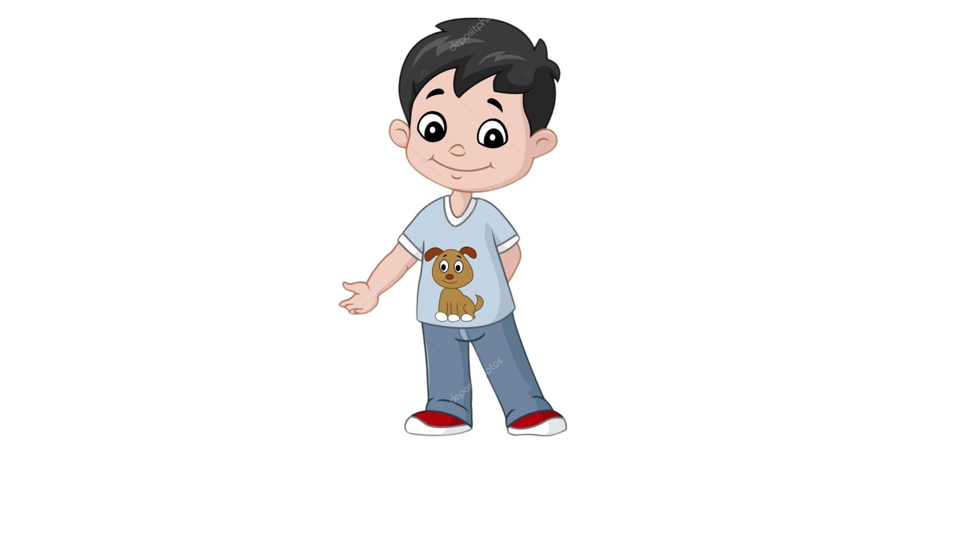
And this is Bobby

Slide 44
Bobby decides that he wants to scare Sophia

Slide 45
Bobby decides that he will hide behind the chair

Slide 46
Then he will call Sophia into the room and jump out to scare her!

Slide 47
Bobby goes to hide behind the chair.

Slide 48
See Bobby is hiding behind the chair.

Slide 49
Now he calls Sophia into the room

Slide 50
Sophia is now in the room

Slide 51
Bobby then jumps out and goes …

Slide 52
Boo!

Slide 53
Sophia falls into the mirror!

Slide 54
The mirror ended up cracking. See the mirror is cracked!

Slide 55
Luckily nobody got hurt—Sophia was OK.

Slide 56
Now that you saw what happened we would like to ask you a couple of questions

Slide 57
Who caused the mirror to crack?

Slide 58
Who cracked the mirror?

